Slide 1
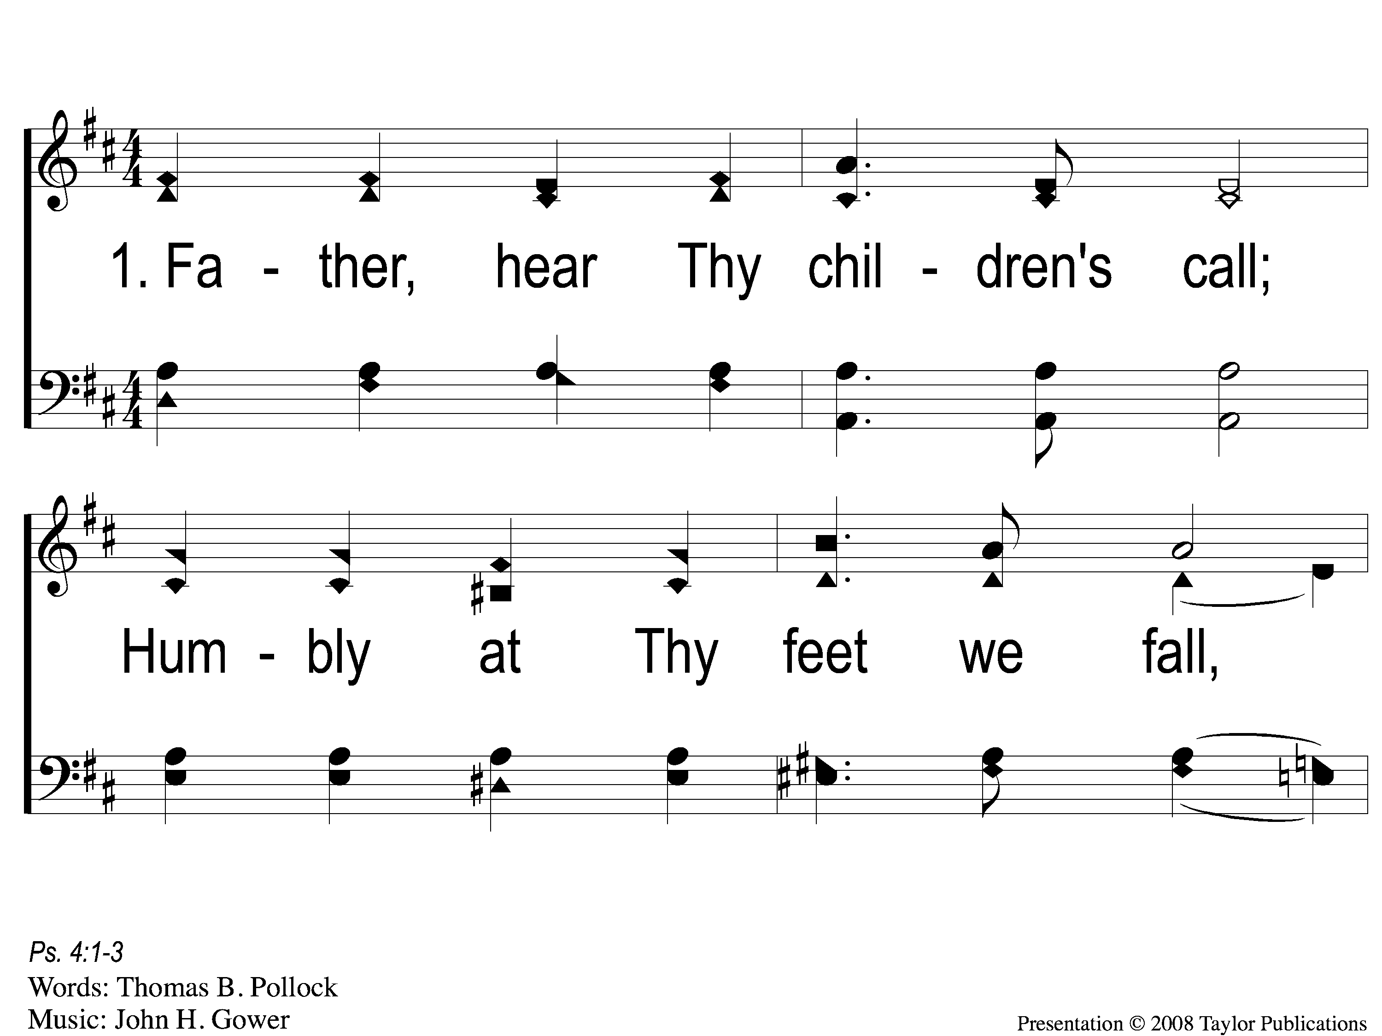
1-1 Father Hear Thy Children’s Call
Father Hear Thy Children’s Call
54

Slide 2
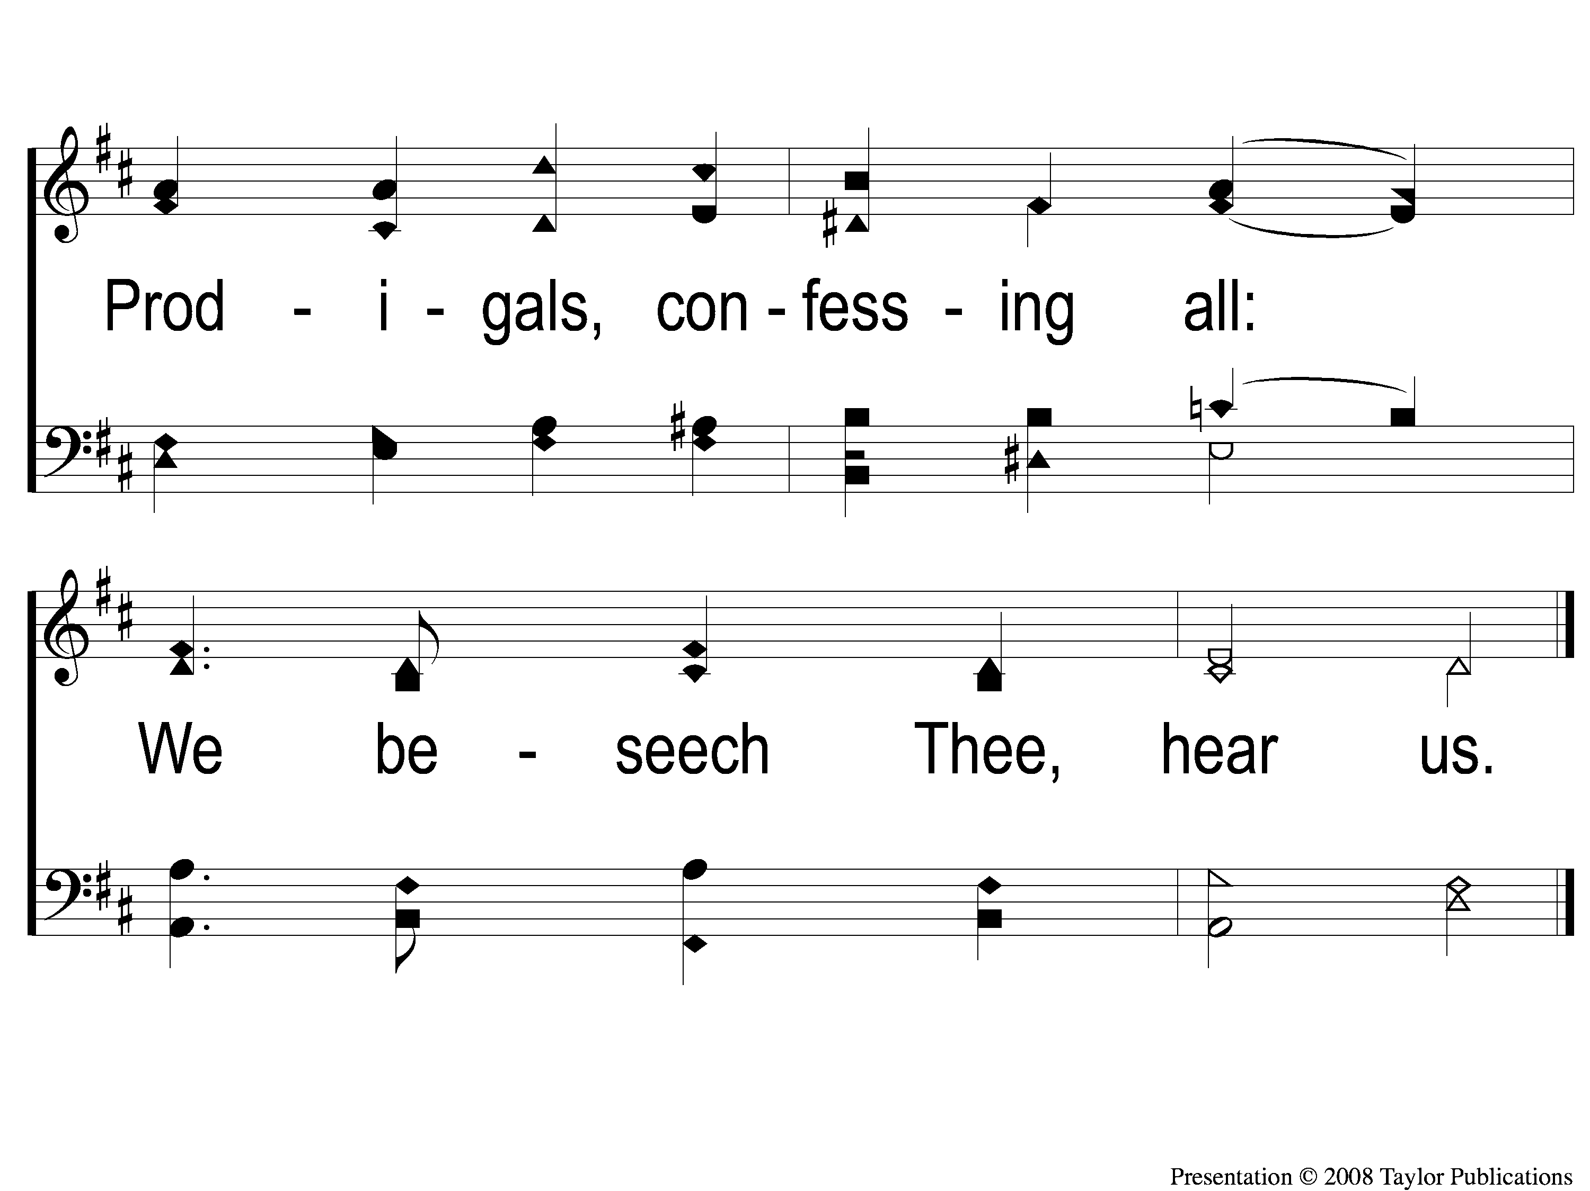
1-2 Father Hear Thy Children’s Call
Father Hear Thy Children’s Call
54

Slide 3
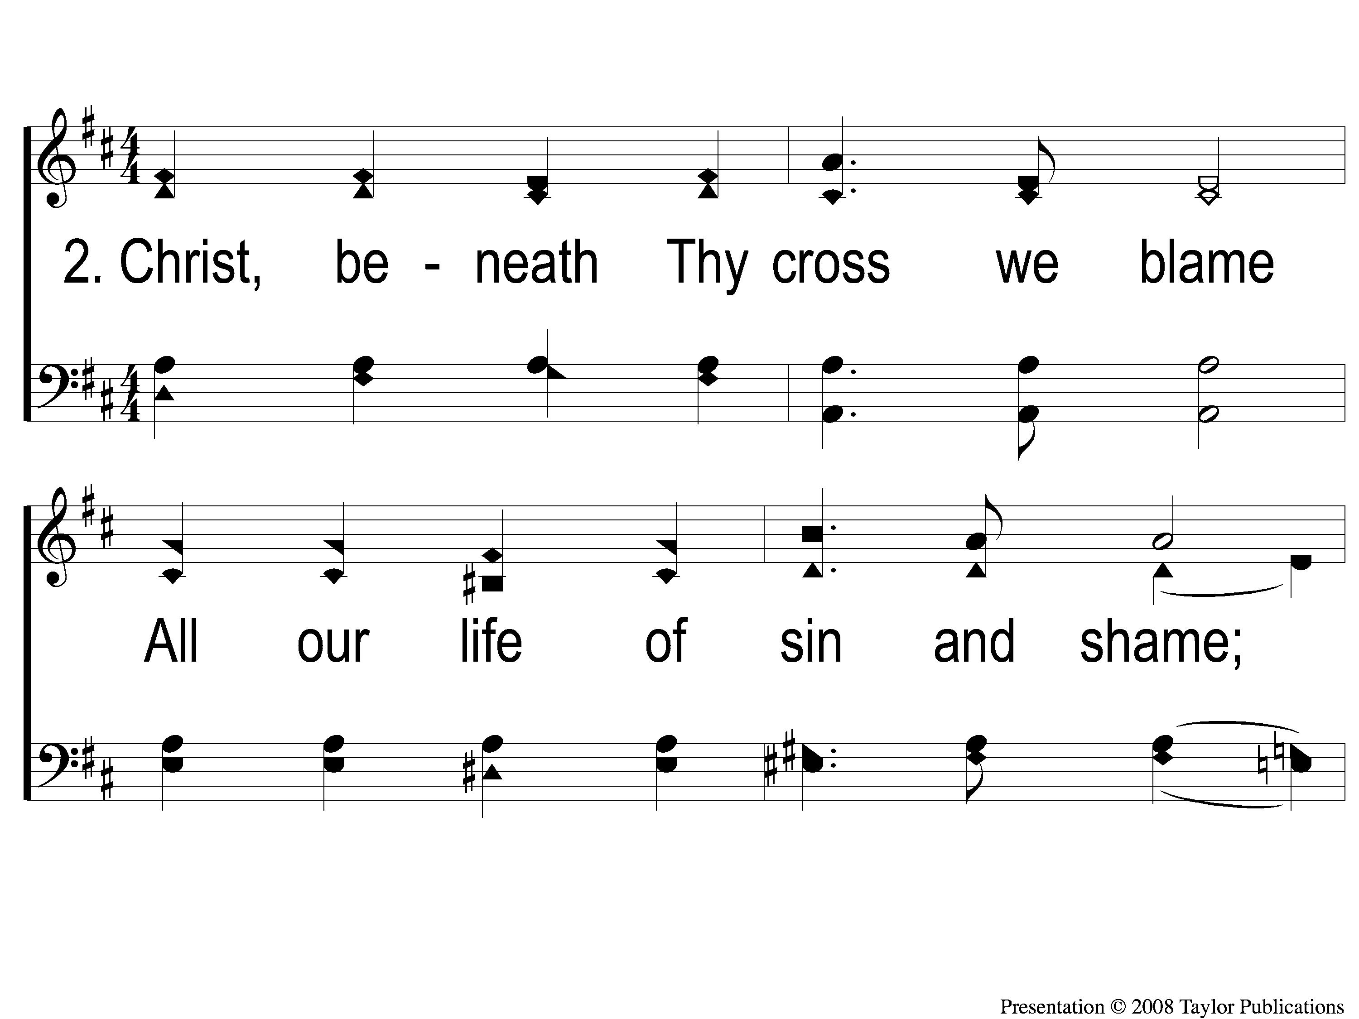
2-1 Father Hear Thy Children’s Call
Father Hear Thy Children’s Call
54

Slide 4
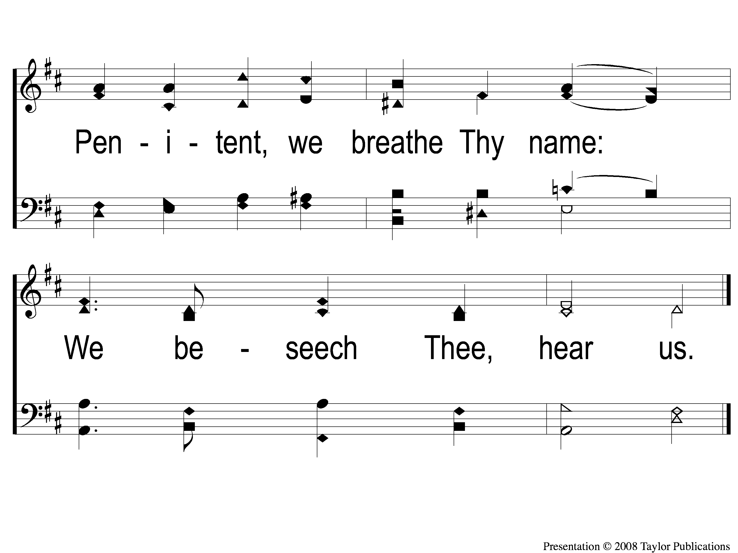
2-2 Father Hear Thy Children’s Call
Father Hear Thy Children’s Call
54

Slide 5
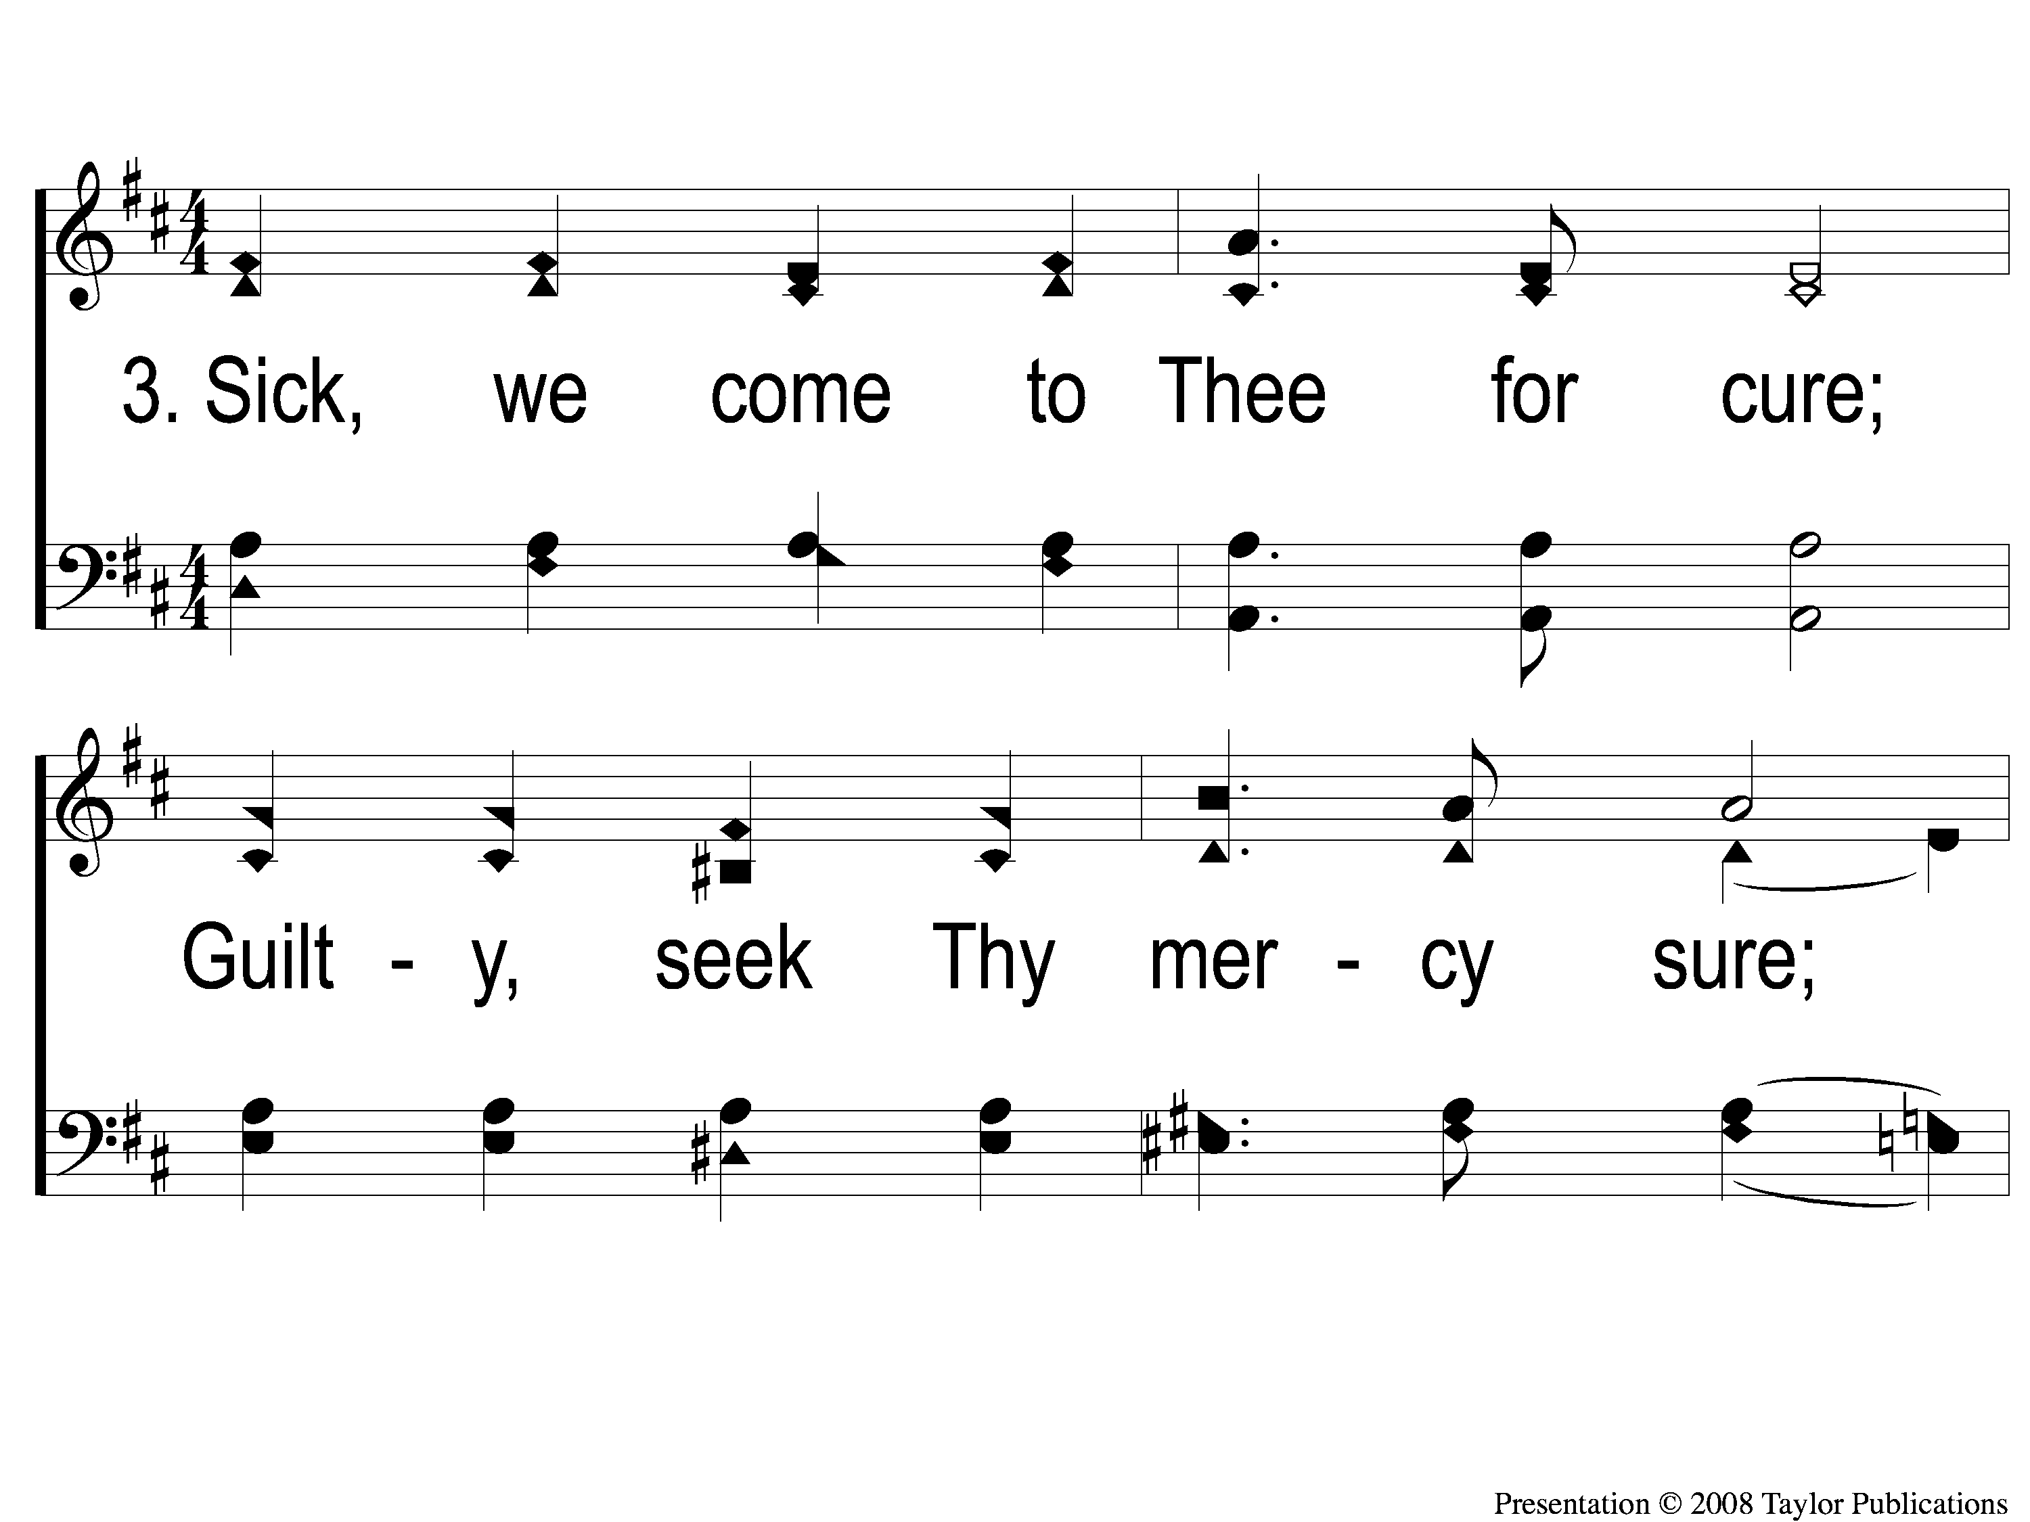
3-1 Father Hear Thy Children’s Call
Father Hear Thy Children’s Call
54

Slide 6
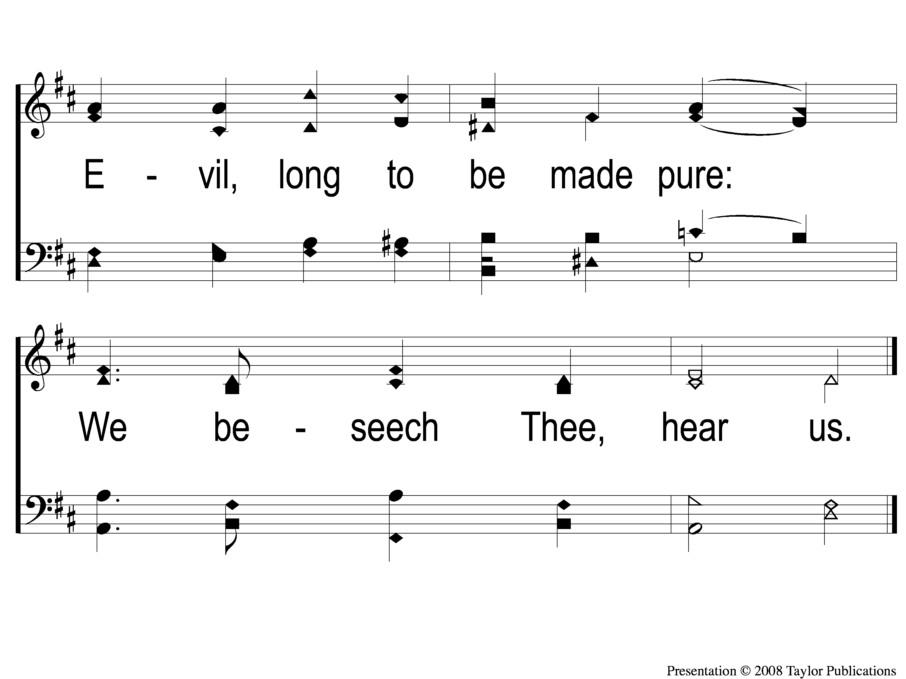
3-2 Father Hear Thy Children’s Call
Father Hear Thy Children’s Call
54

Slide 7
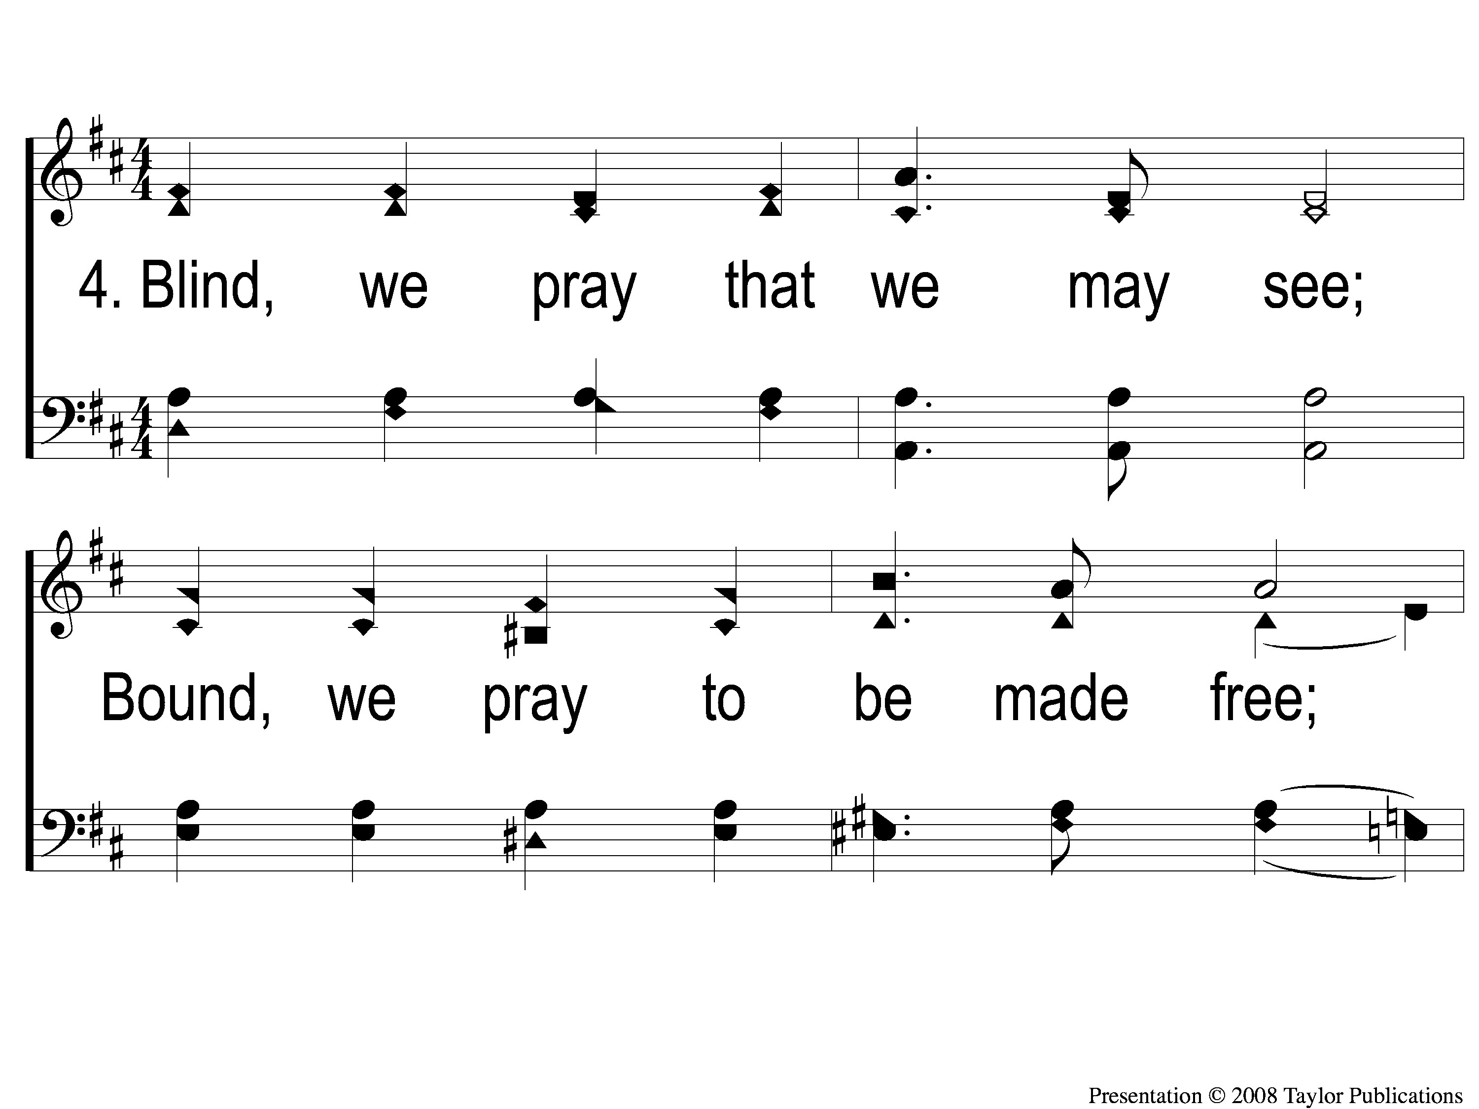
4-1 Father Hear Thy Children’s Call
Father Hear Thy Children’s Call
54

Slide 8
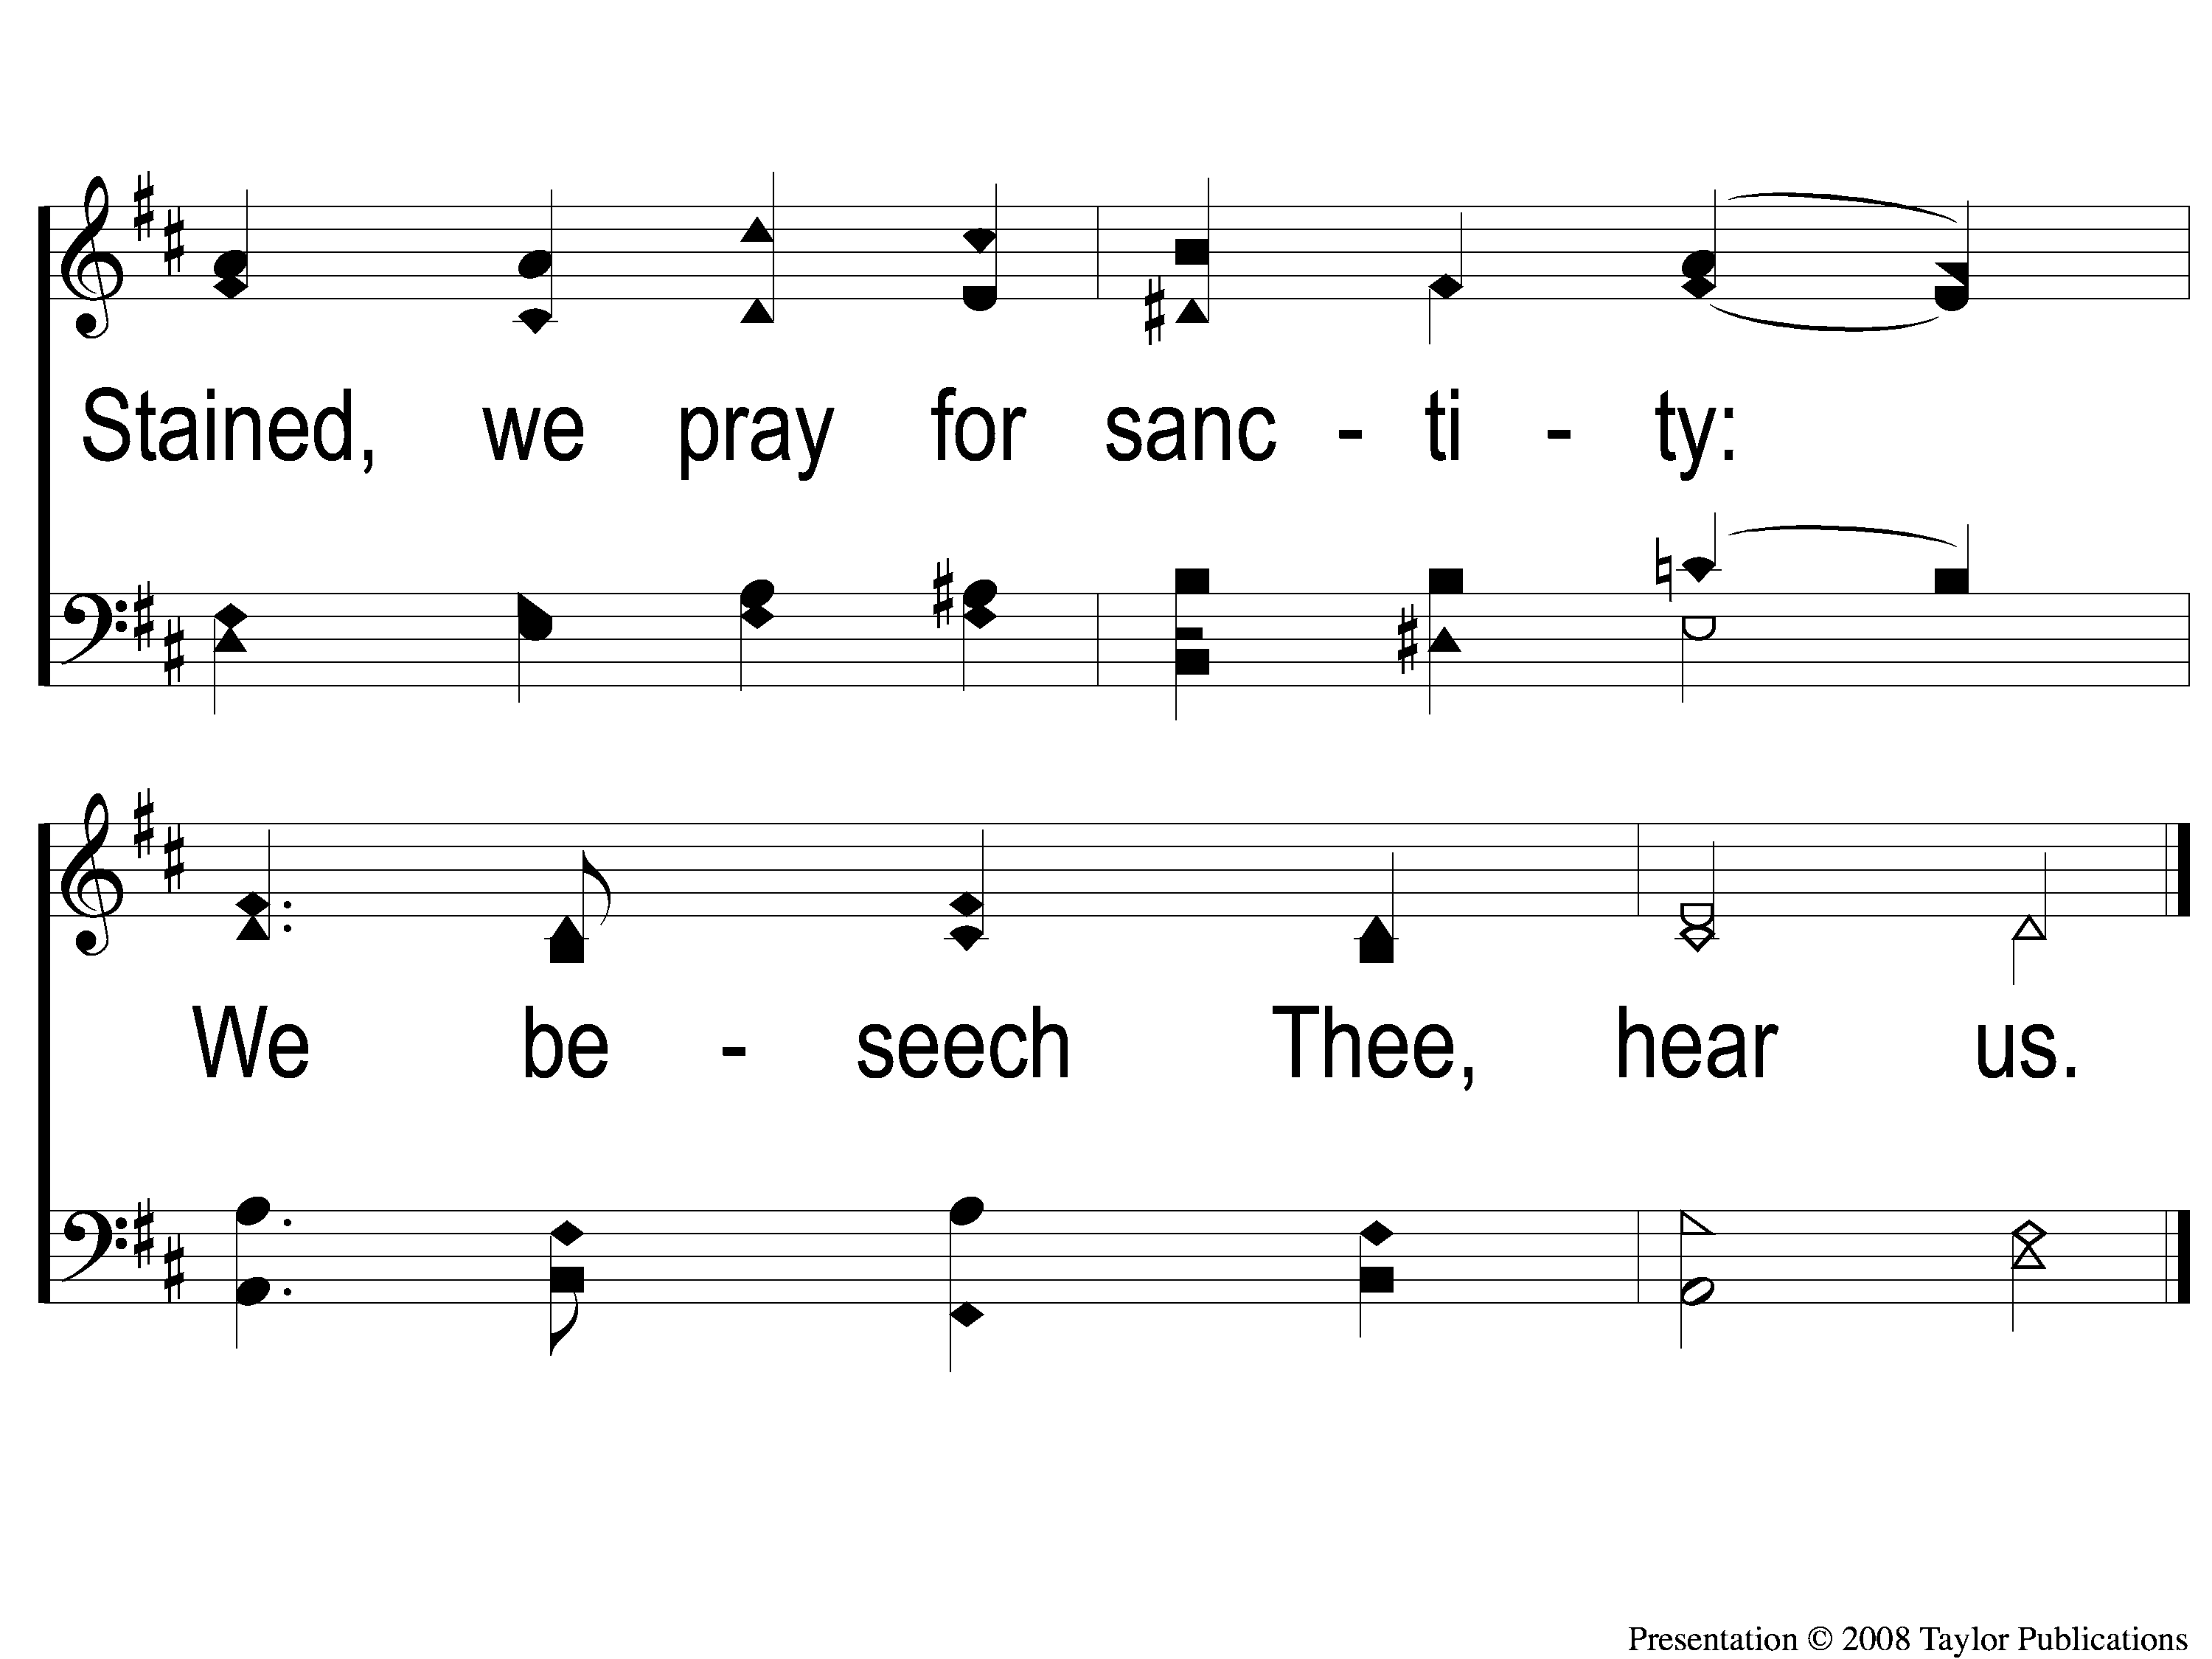
4-2 Father Hear Thy Children’s Call
Father Hear Thy Children’s Call
54

Slide 9
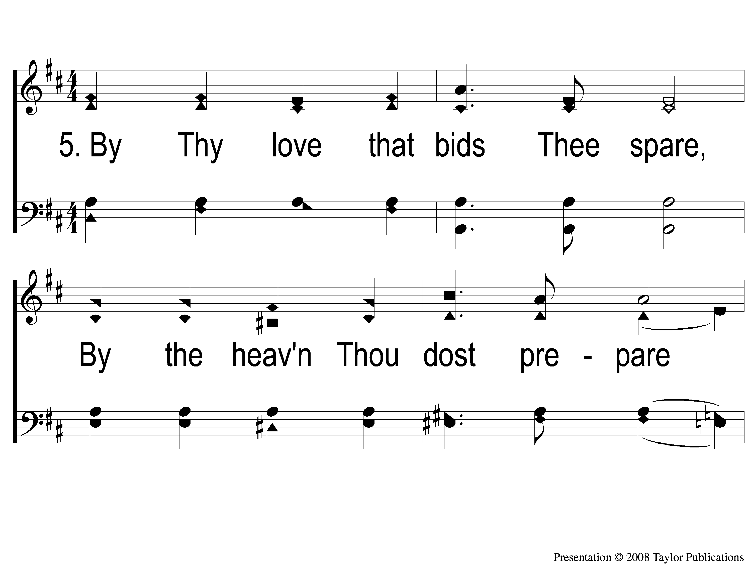
5-1 Father Hear Thy Children’s Call
Father Hear Thy Children’s Call
54

Slide 10
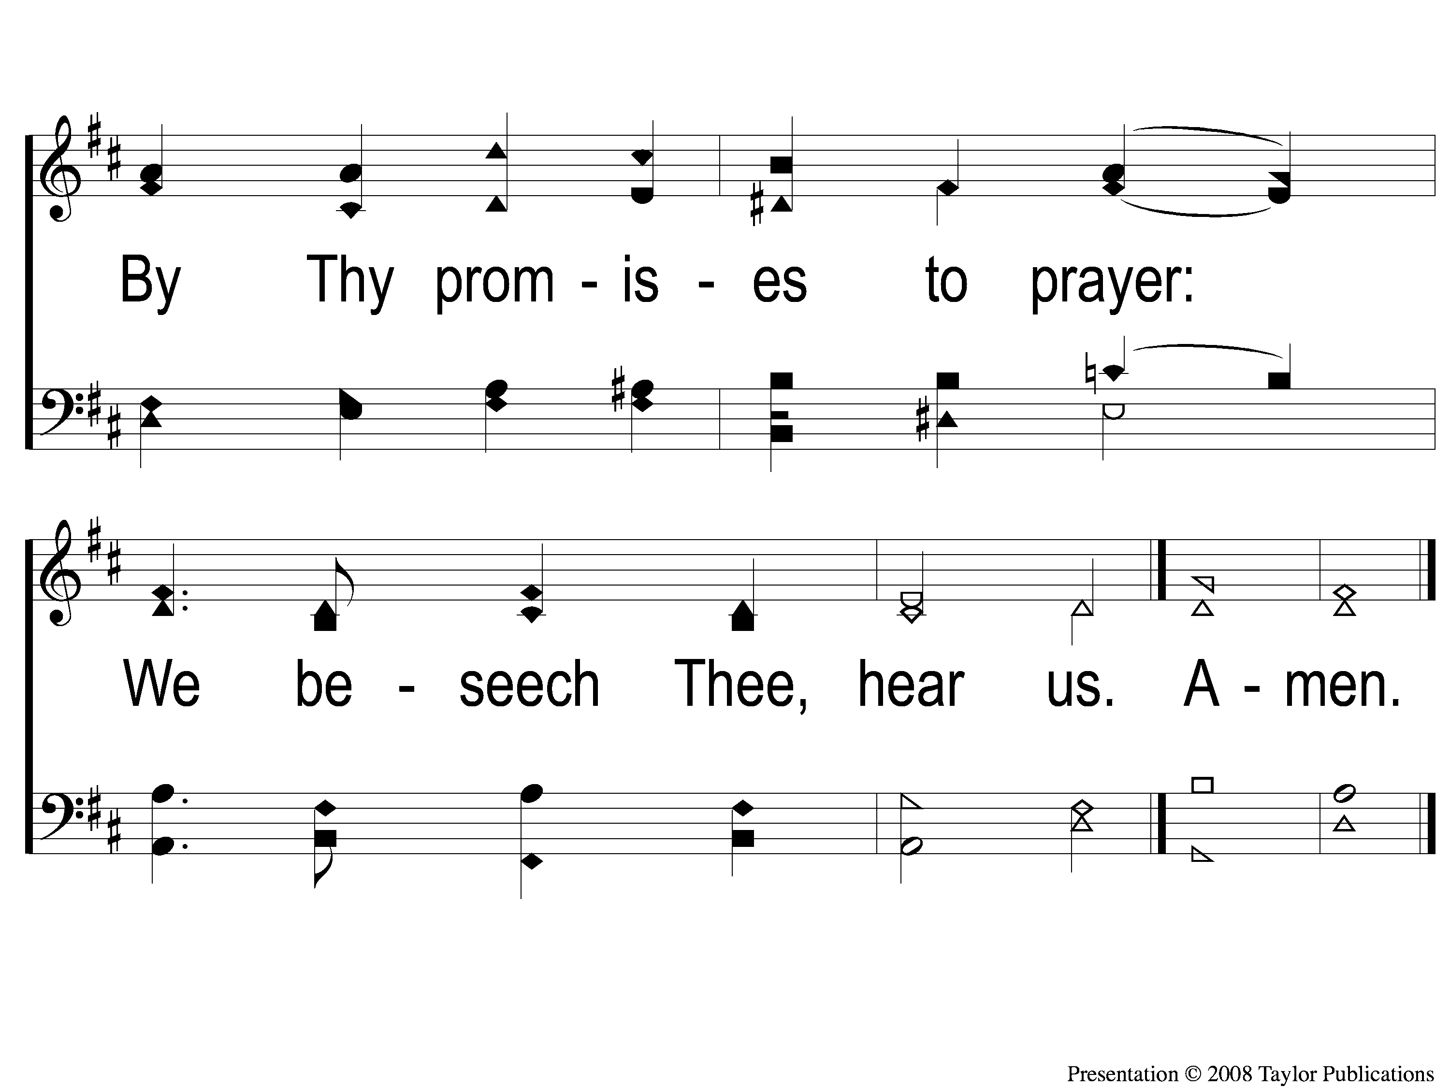
5-2 Father Hear Thy Children’s Call
Father Hear Thy Children’s Call
54

